Slide 1
My (slightly odd) path here

Slide 2
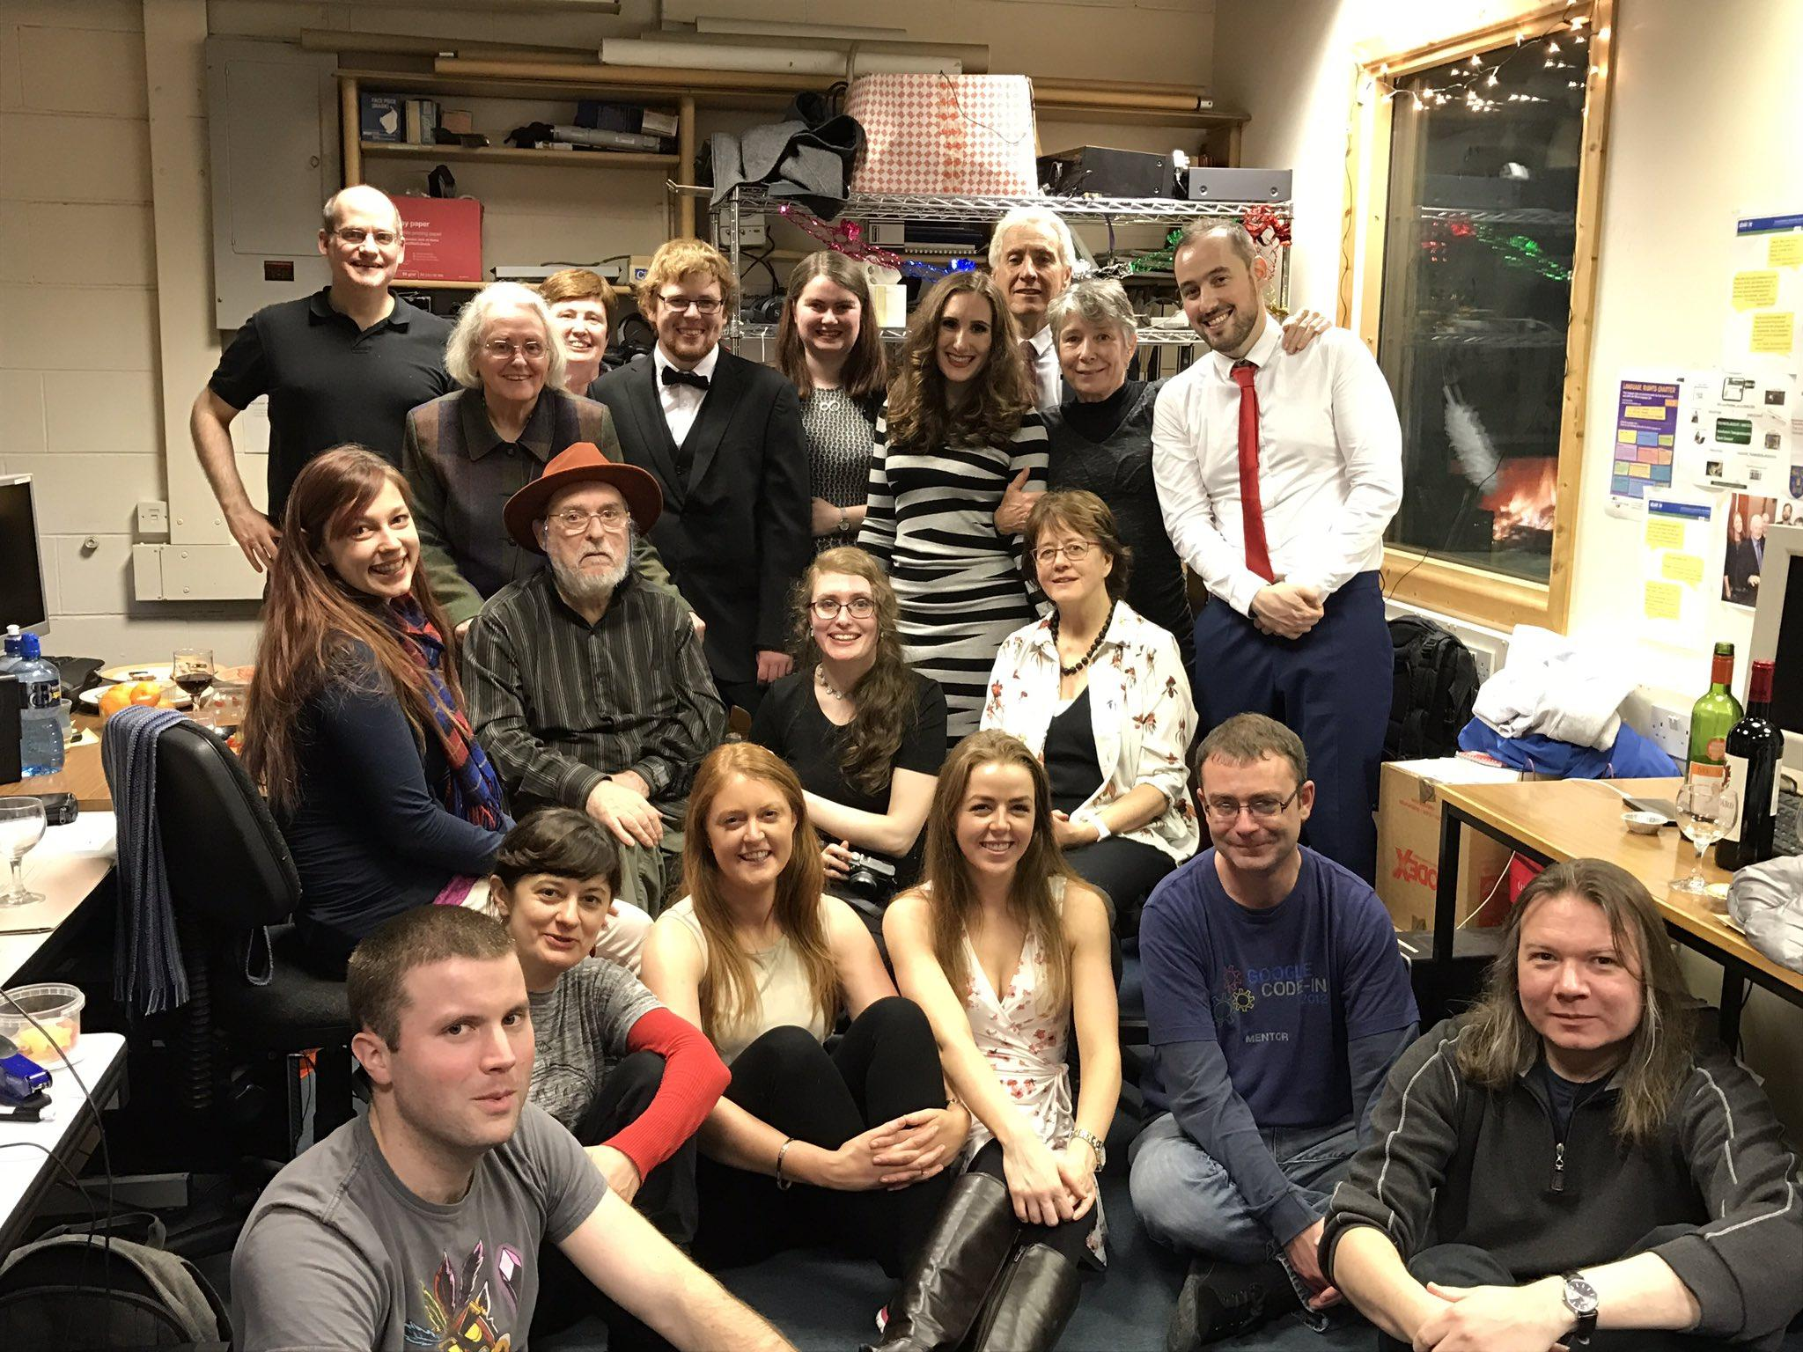
Master’s, Trinity: Machine Translation
Neasa Ní Chiaráin, Twitter: https://twitter.com/nichiarain/status/806900082356457472

Slide 3
Dissertation writing: Aug/Sept 2017
June 2017: "Attention is all you need"
Everything obsolete
Minor mental breakdown
Never touching machine translation again

Slide 4
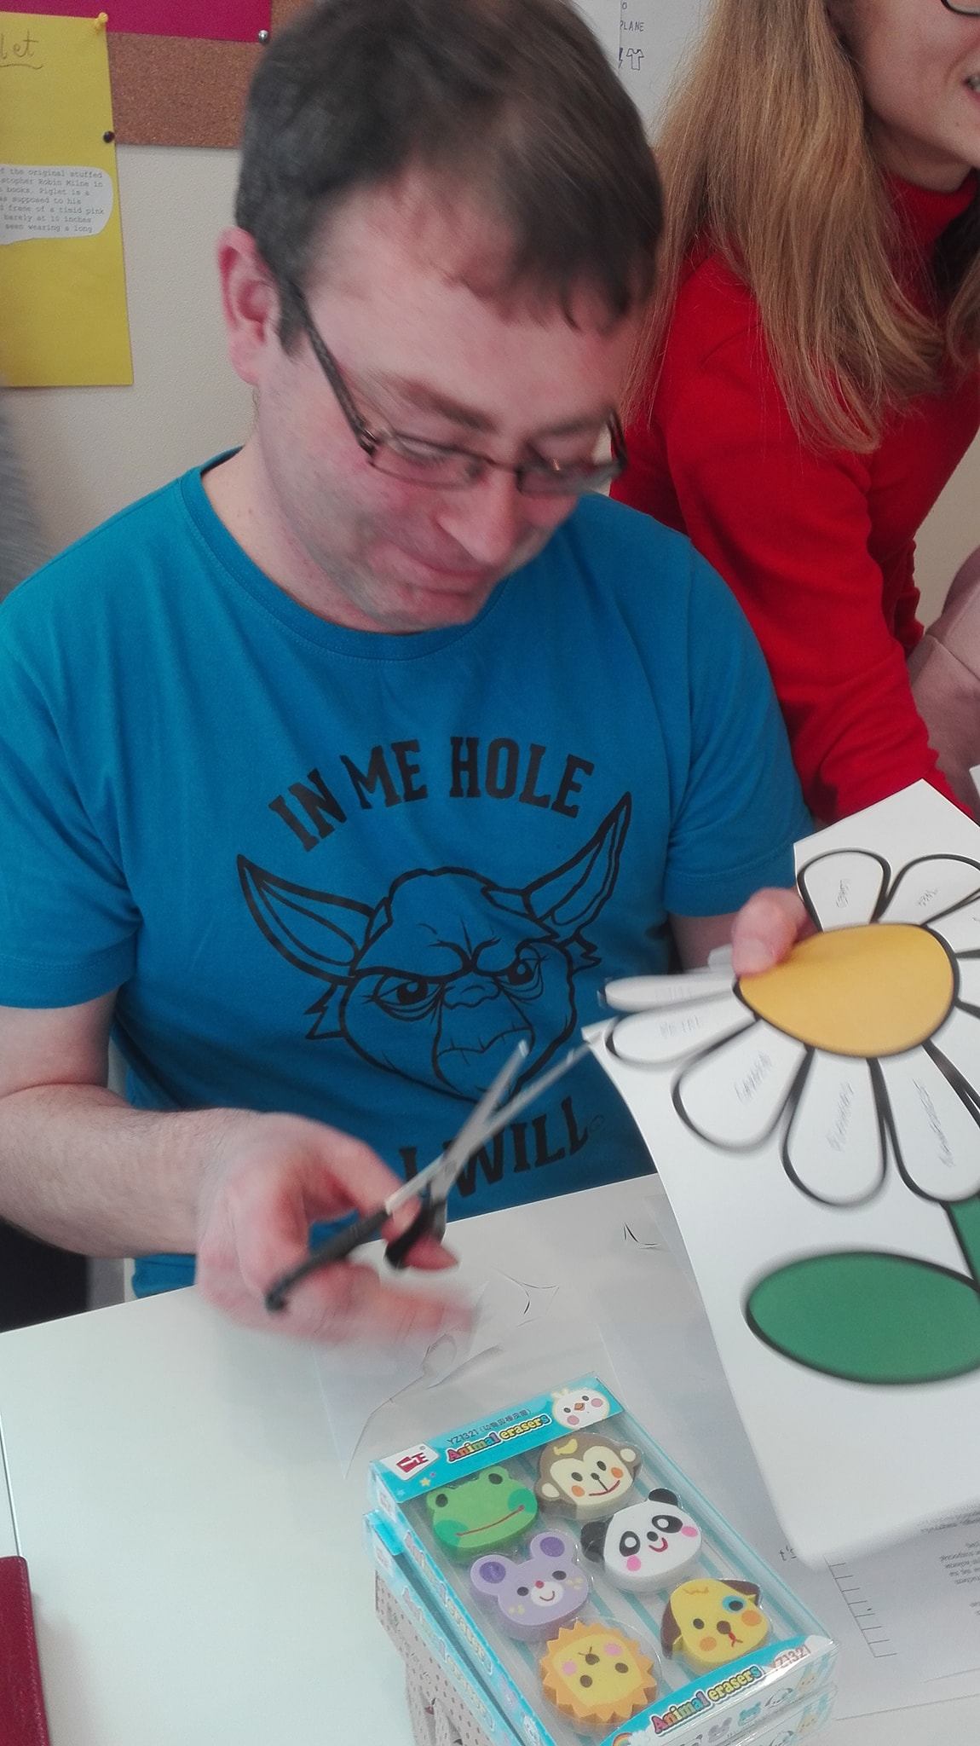
I taught English in Poland
CLIL Szkoła Językowa, Facebook
https://www.facebook.com/CLILSzkolaJezykowa/posts/pfbid02xKQMiavwiQ9iTyLmtTCoBr7yjViedPy1to7FJfnGjk5EiEL4kyXCj4dSJc3qFe8Xl

Slide 5
In brief:
March 2021
Huggingface wav2vec2 fine tuning event
Slack channel created for the event
May 2021
This Birger dude asked on Slack for help with wav2vec-u
wav2vec-u uses Kaldi. I offered to help: I’ve already suffered, let’s break the cycle of suffering
June 2021
Birger: “Hey, have you ever considered moving to Stockholm?”
Birger set up a meeting
Meeting with Jens
September 2021
When LADOK says I started
January 2022
When I actually started

Slide 6
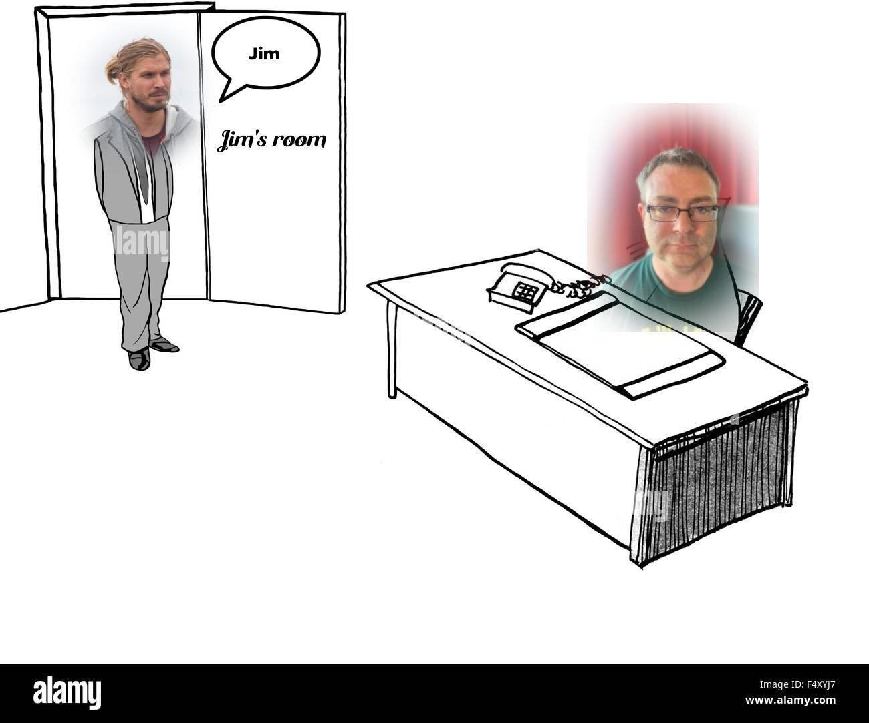
The path to 509

Slide 7
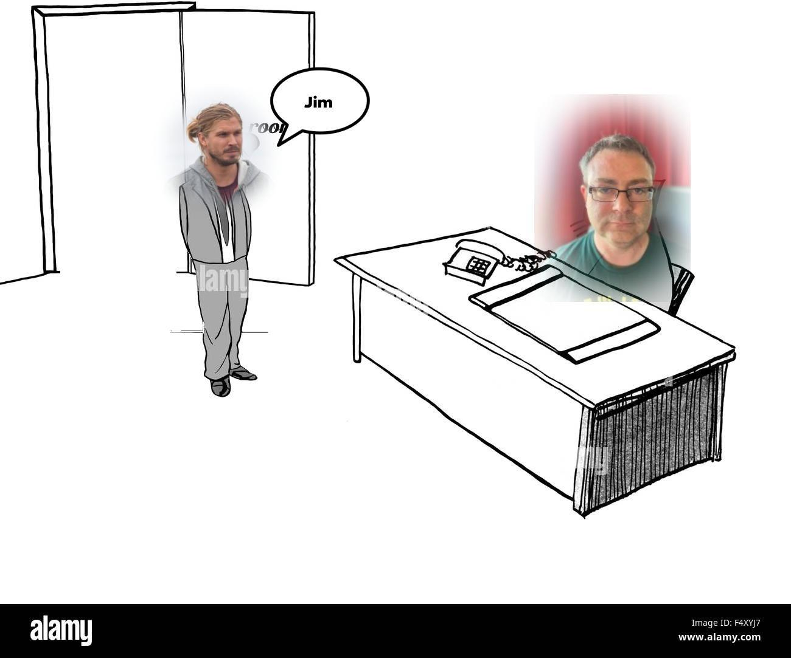
The path to 509

Slide 8
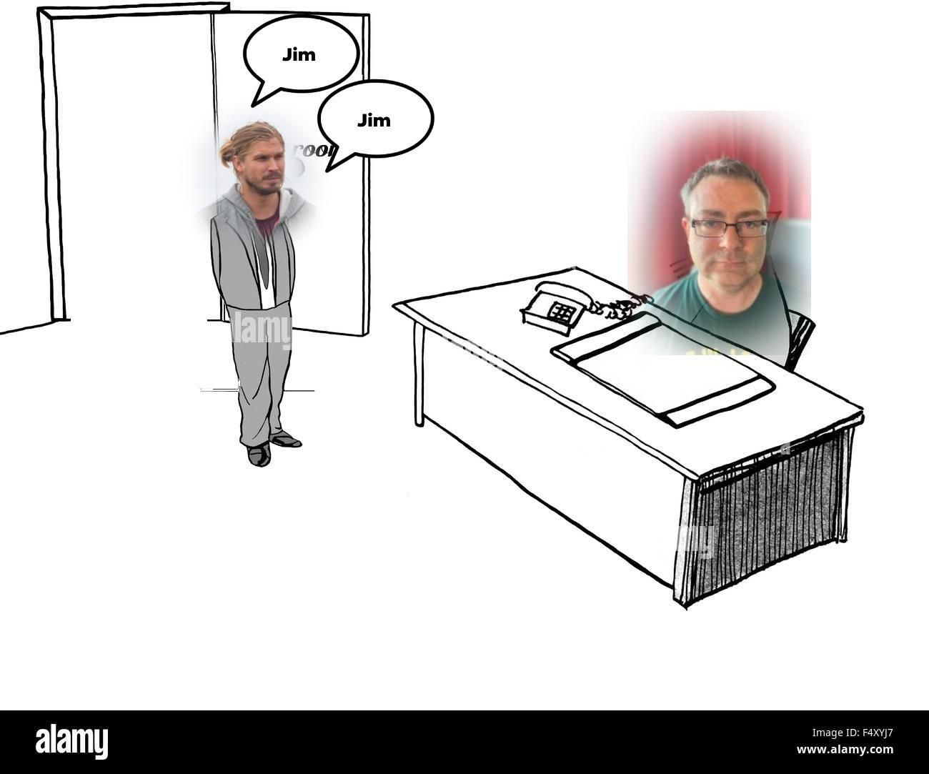
The path to 509

Slide 9
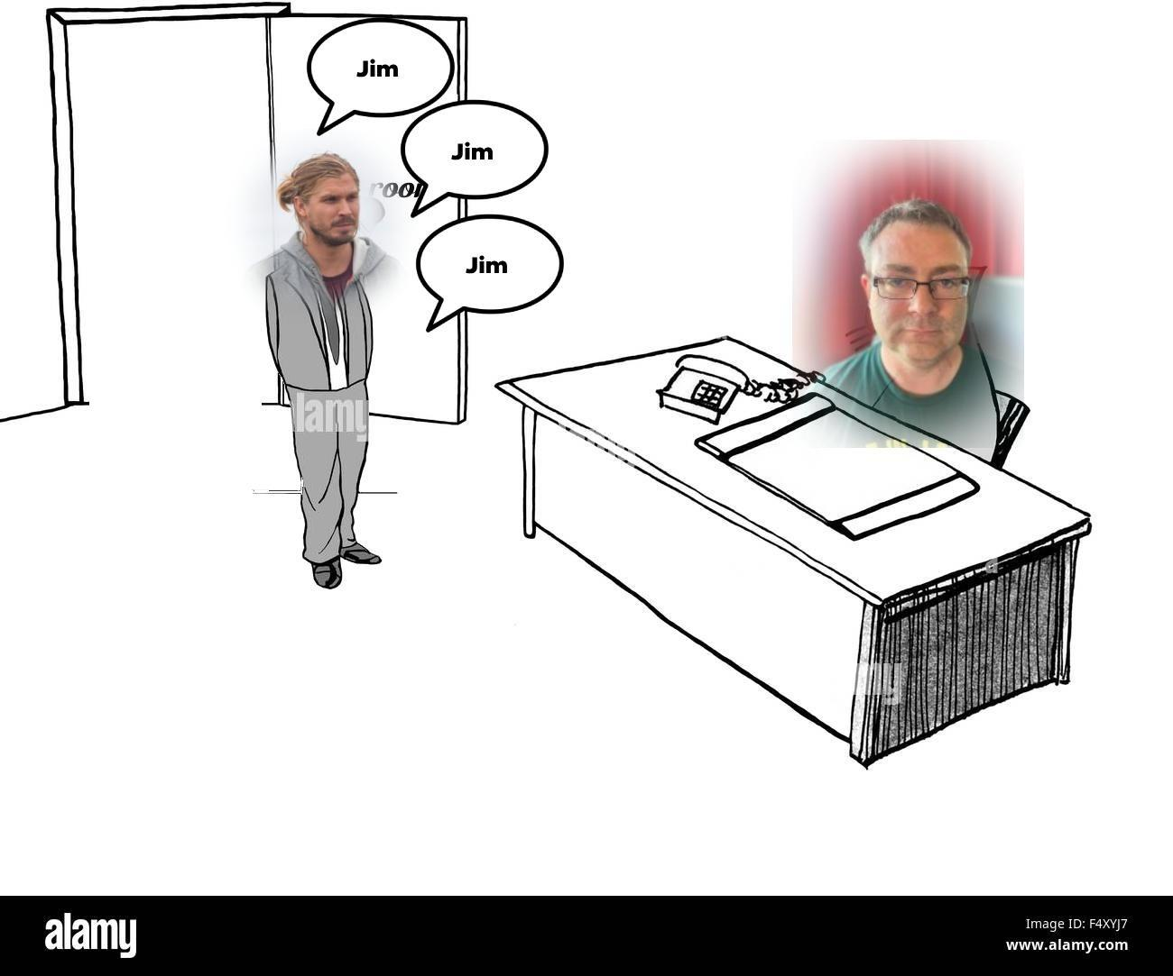
The path to 509

Slide 10
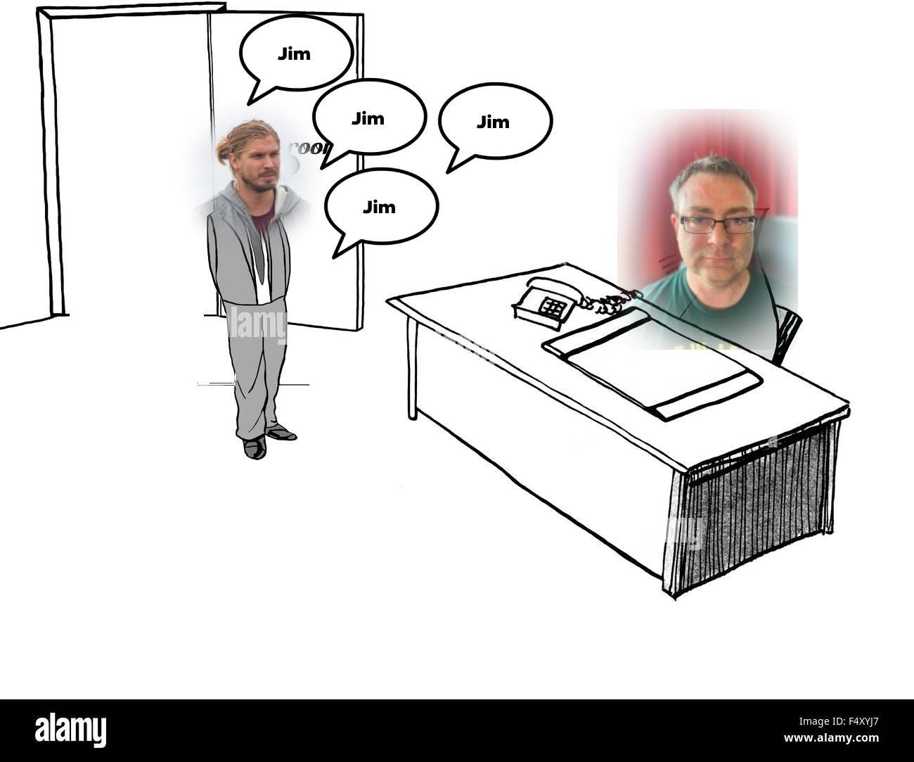
The path to 509

Slide 11
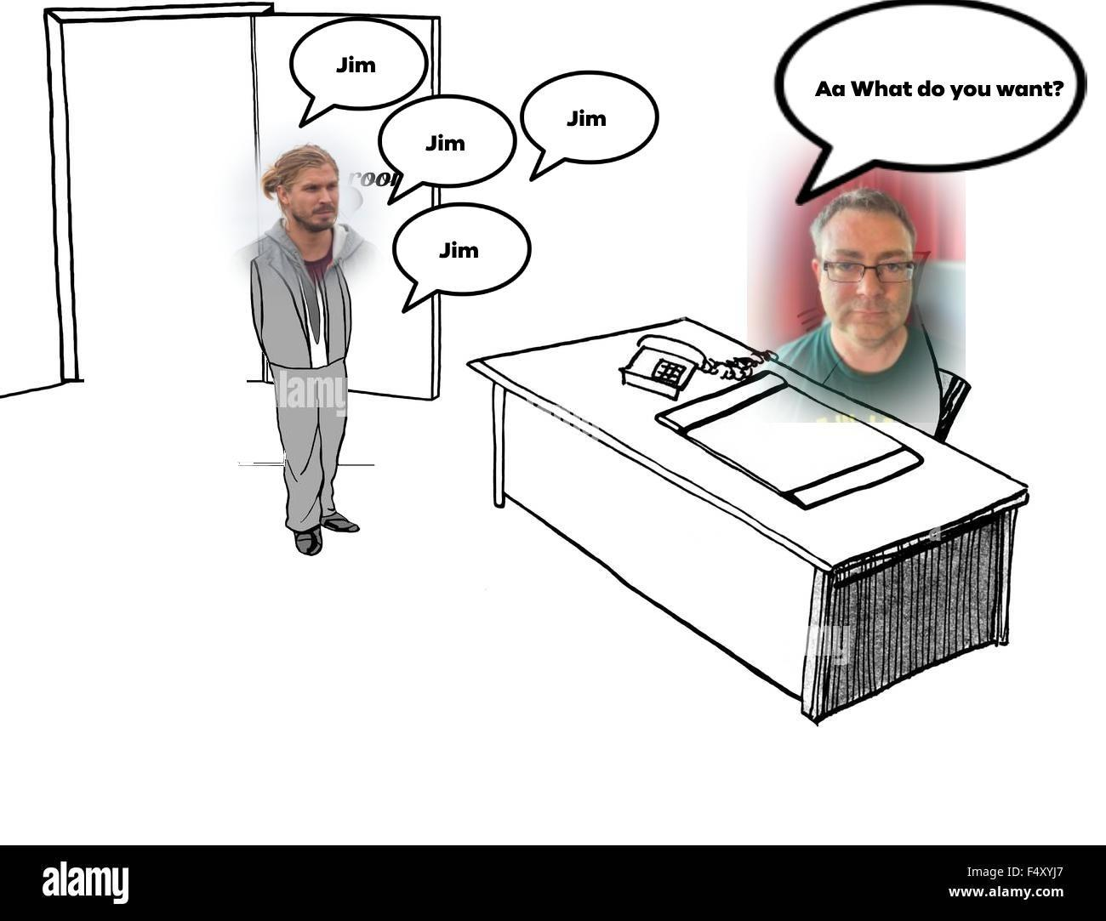
The path to 509

Slide 12
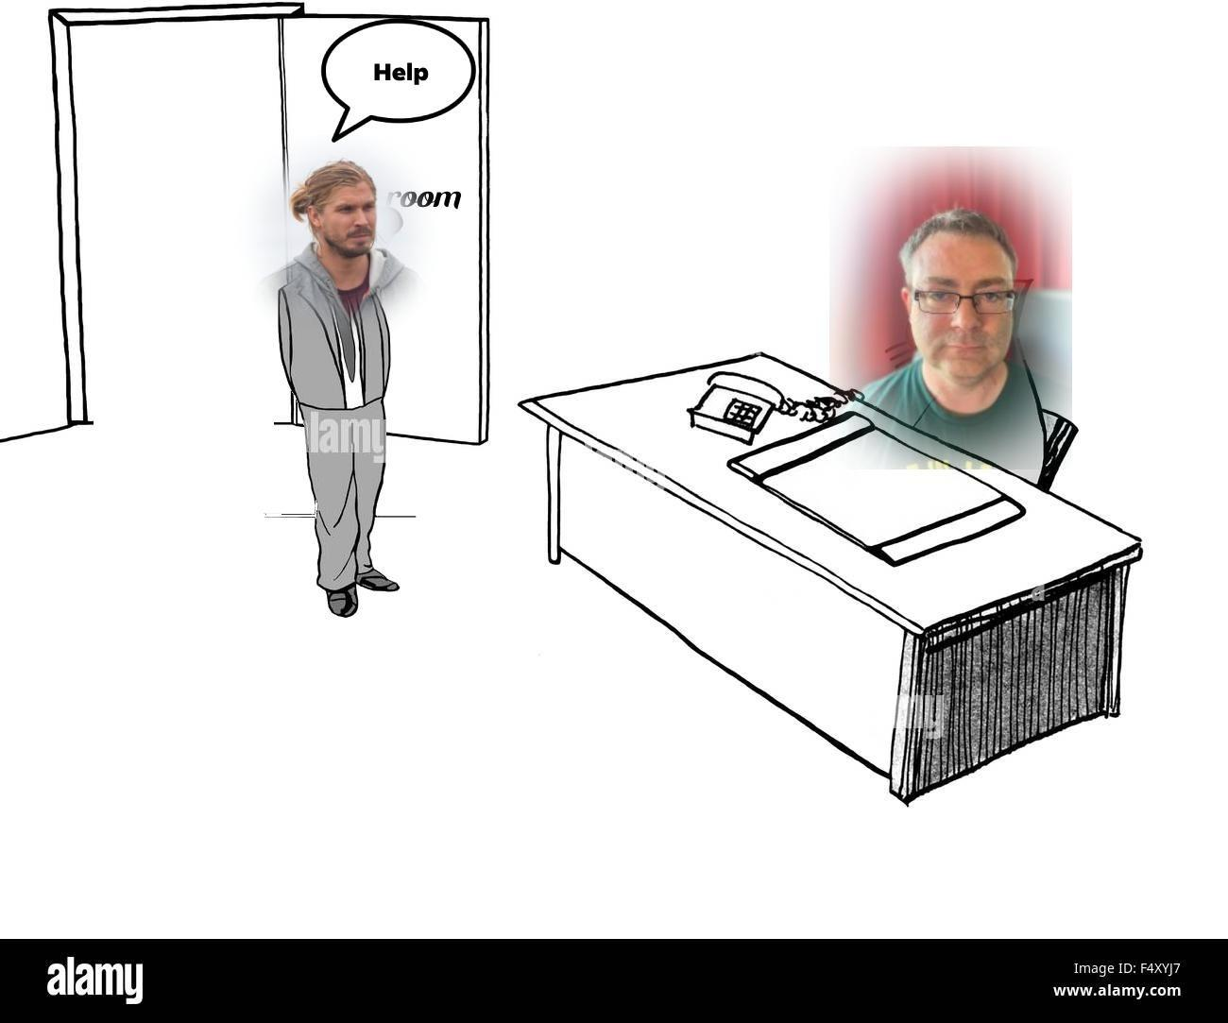
The path to 509

Slide 13
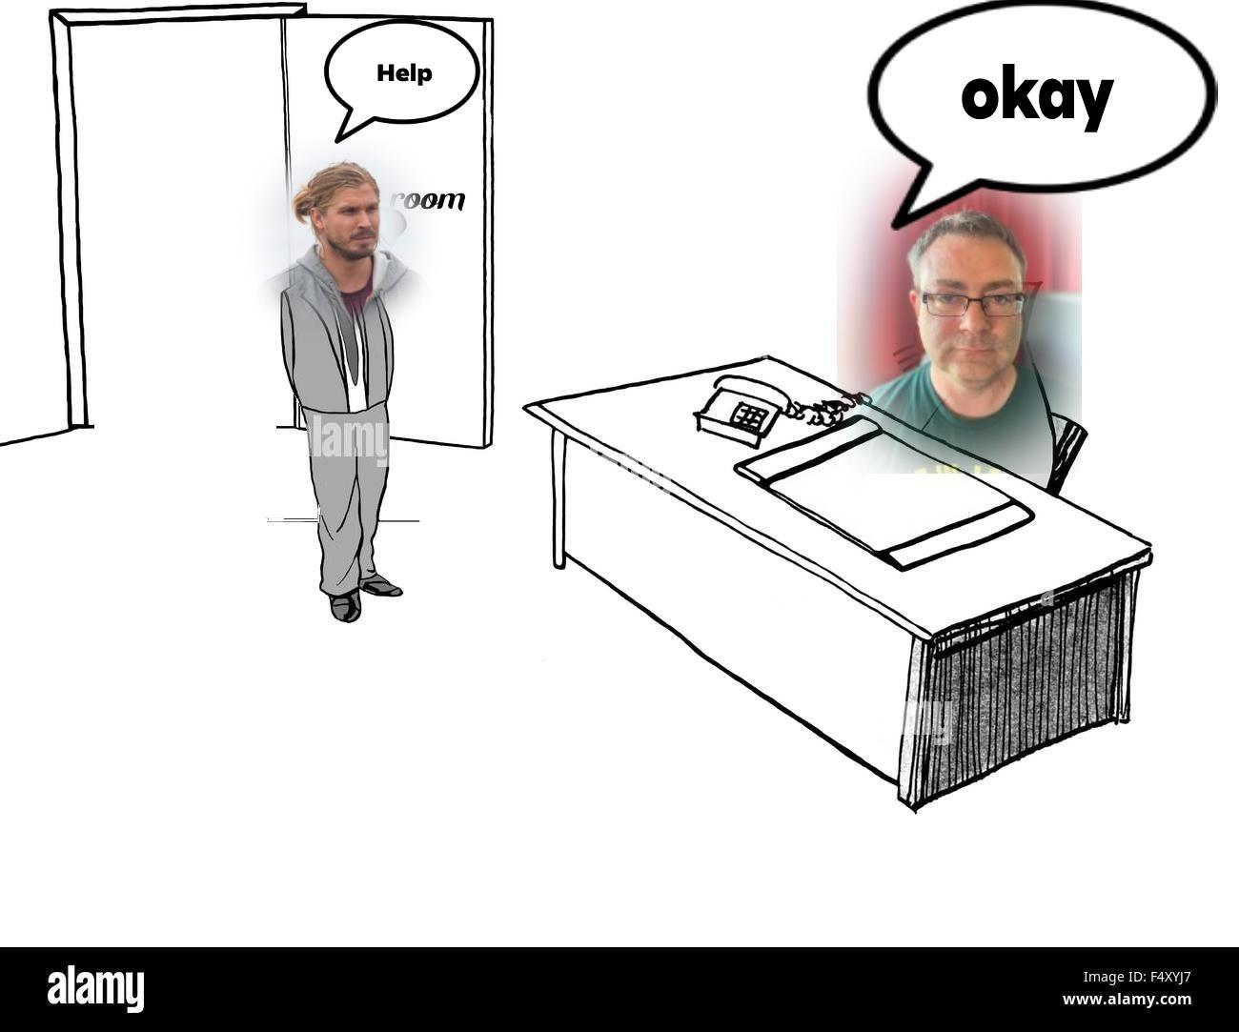
The path to 509

Slide 14
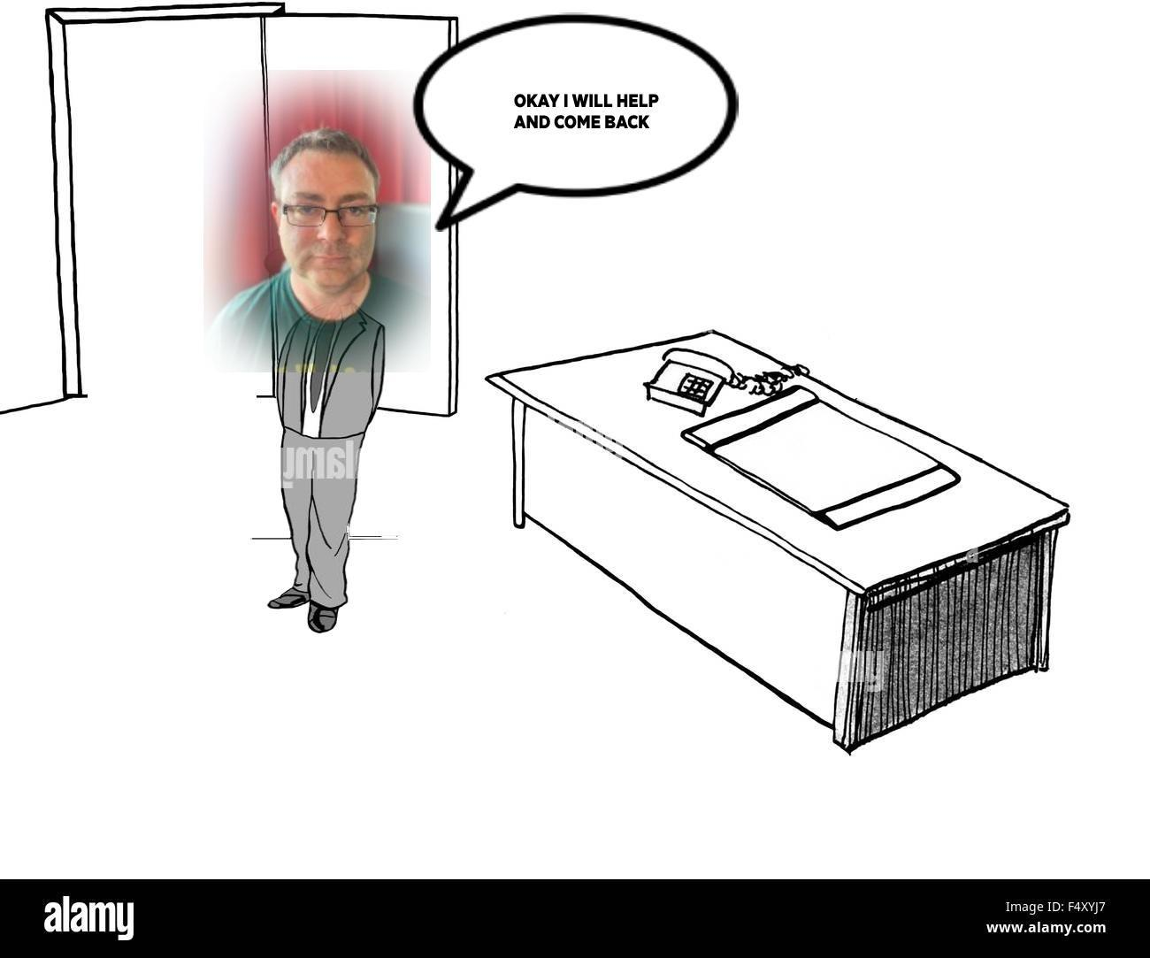
The path to 509

Slide 15
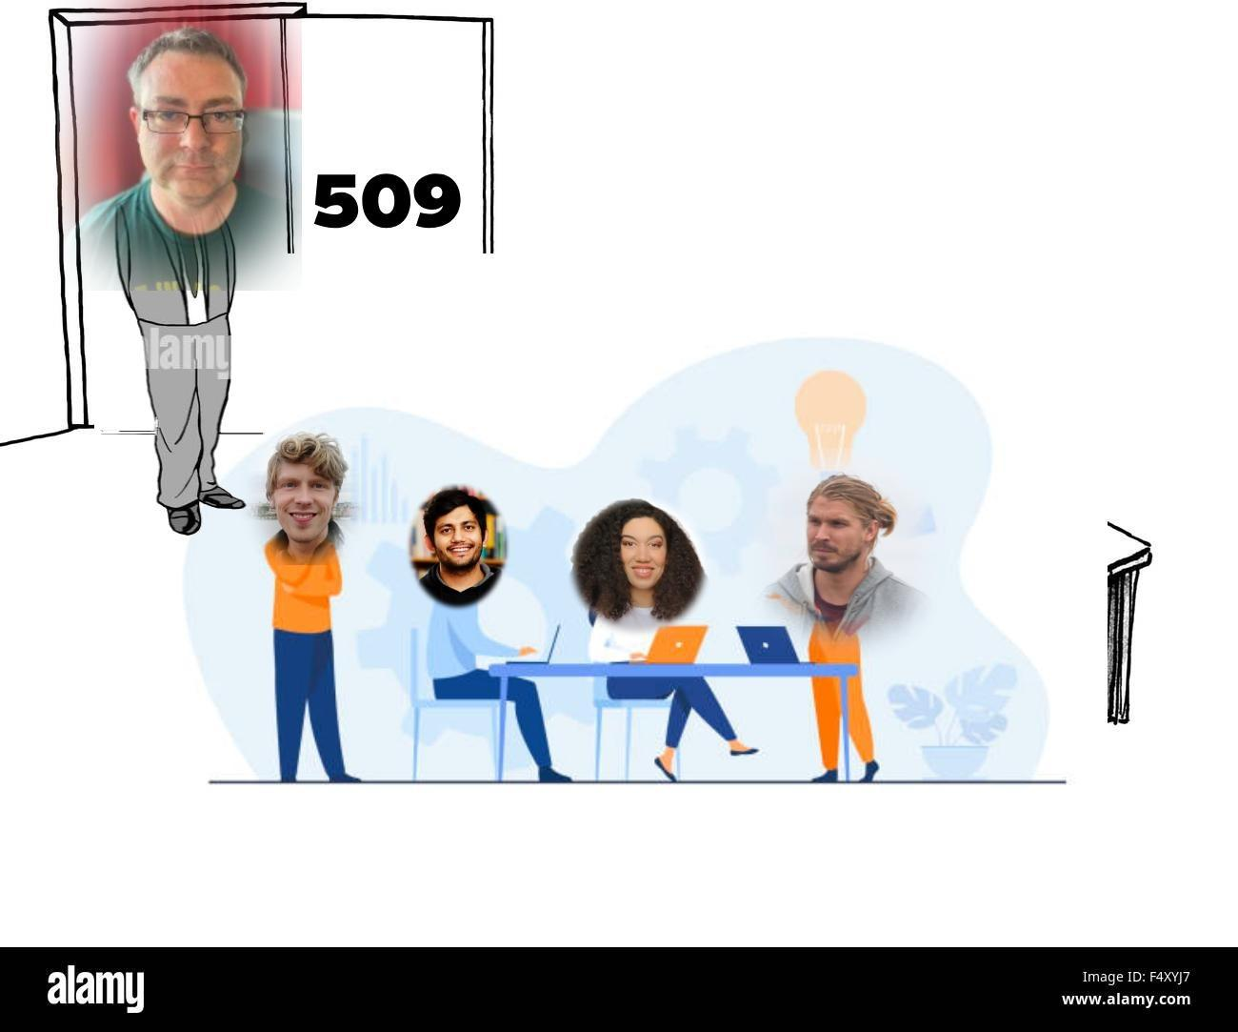
The path to 509

Slide 16
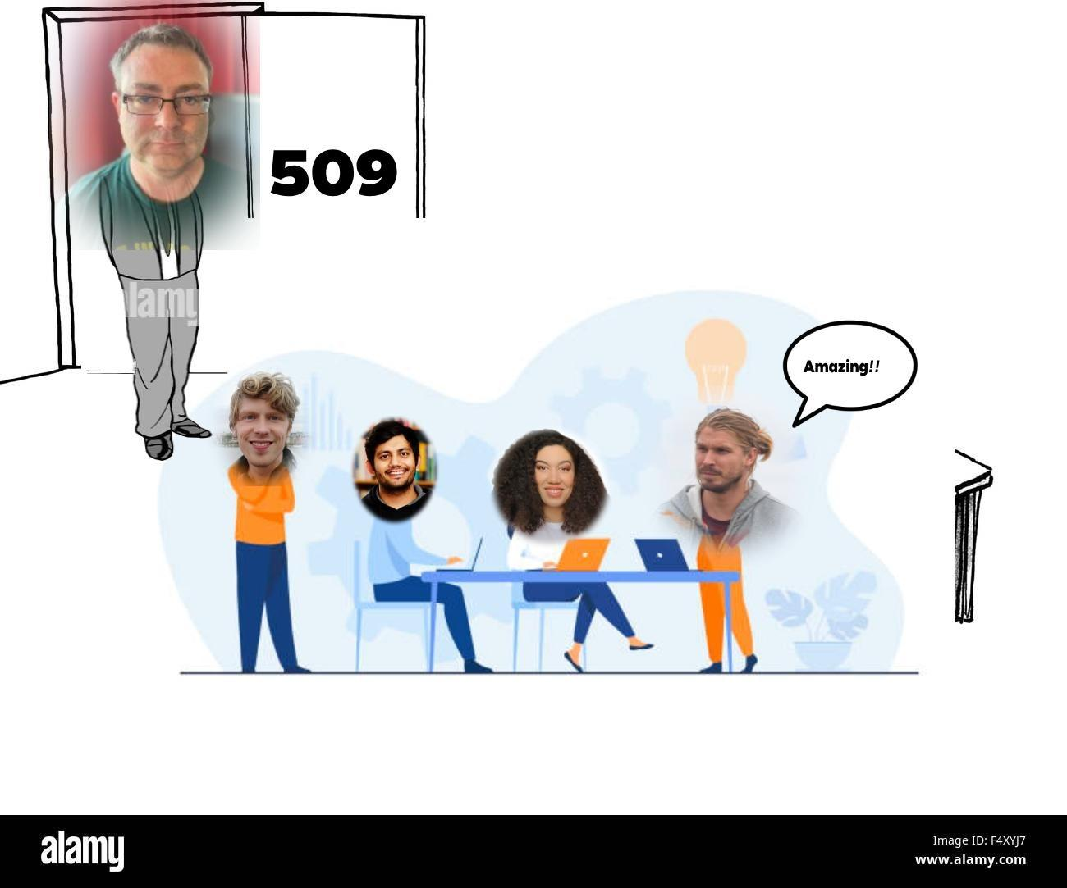
The path to 509

Slide 17
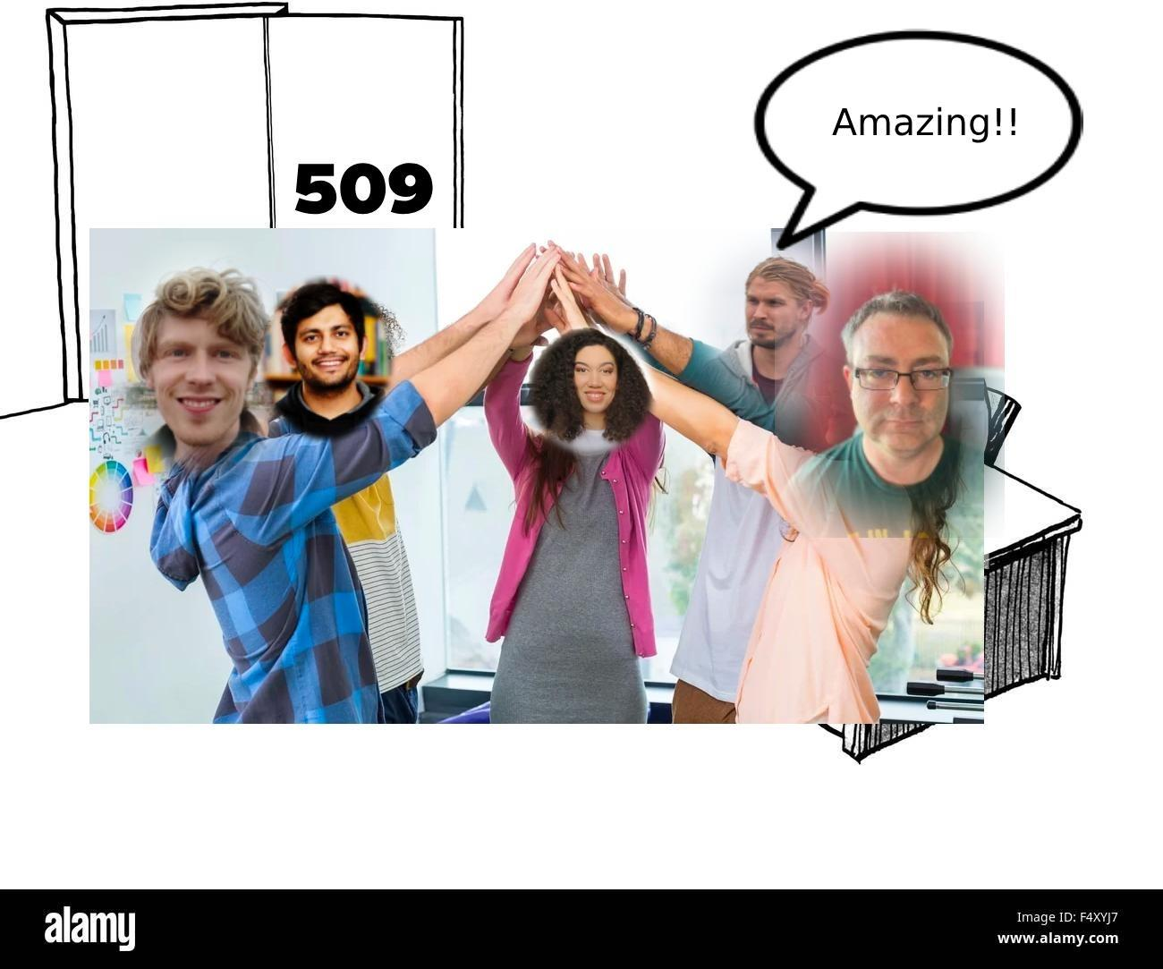
The path to 509

Slide 18
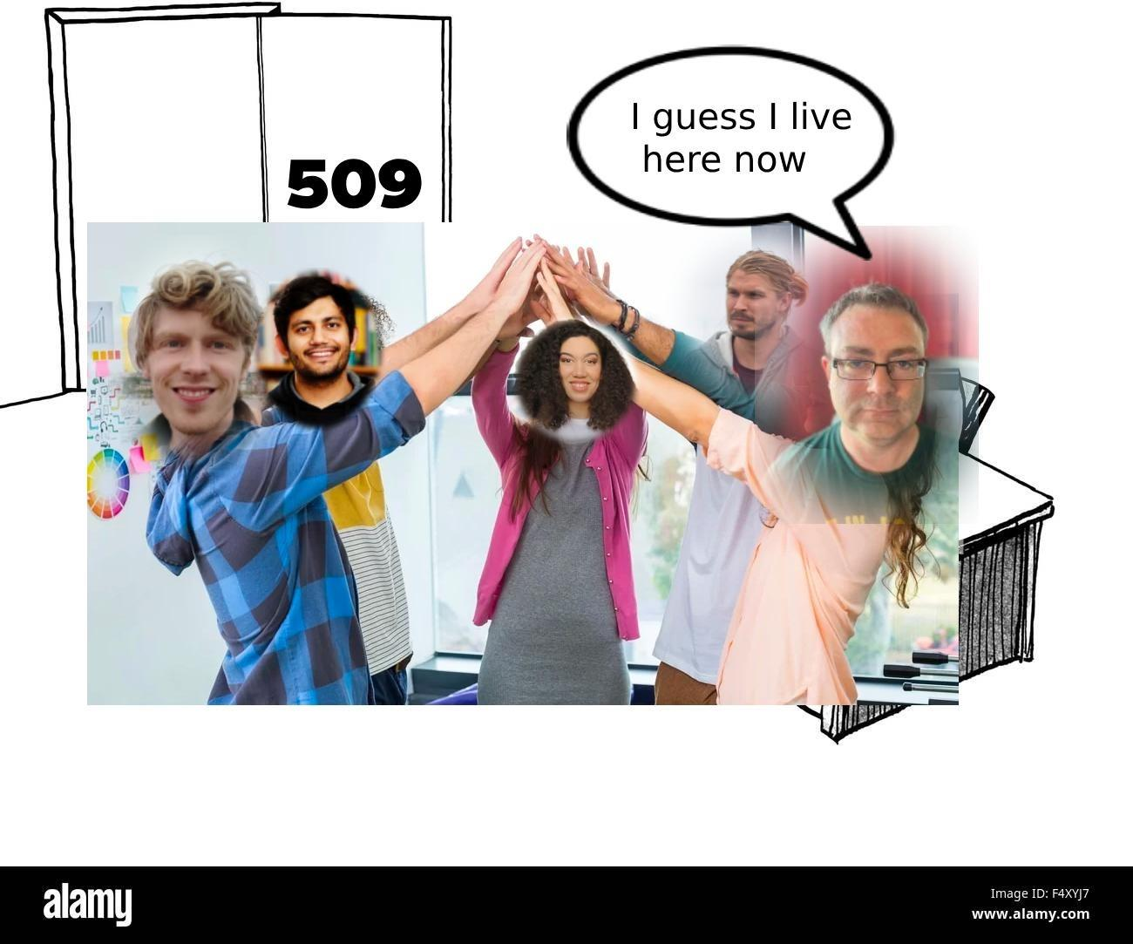
The path to 509

